Slide 1
RDEnvi Project
Robertas Ašvicas
Dmitry Lvov
The Netherlands, 2020

Slide 2
About us - RDEnvi
Robertas Ašvicas
2nd year ICT & Infrastructure students
r.asvicas@student.fontys.nl
+31683639656
Speaks Lithuanian, Russian, Polish and English
Dmitry Lvov
2nd year ICT & Infrastructure students
d.lvov@student.fontys.nl
+31645515337
Speaks Russian, English and Spanish

Slide 3
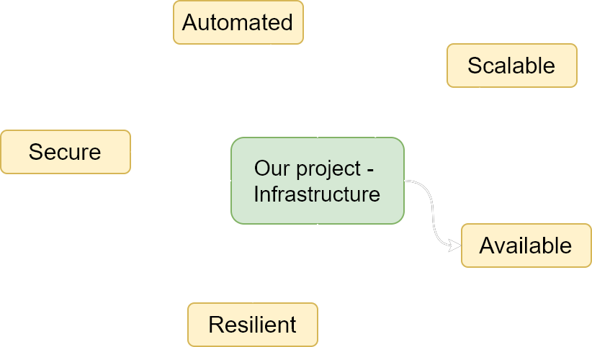
About project

Slide 4
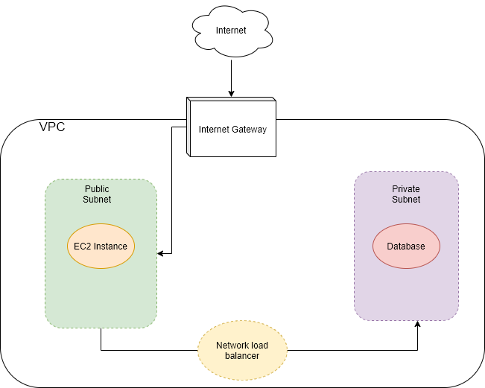
Network diagram No. 1

Slide 5
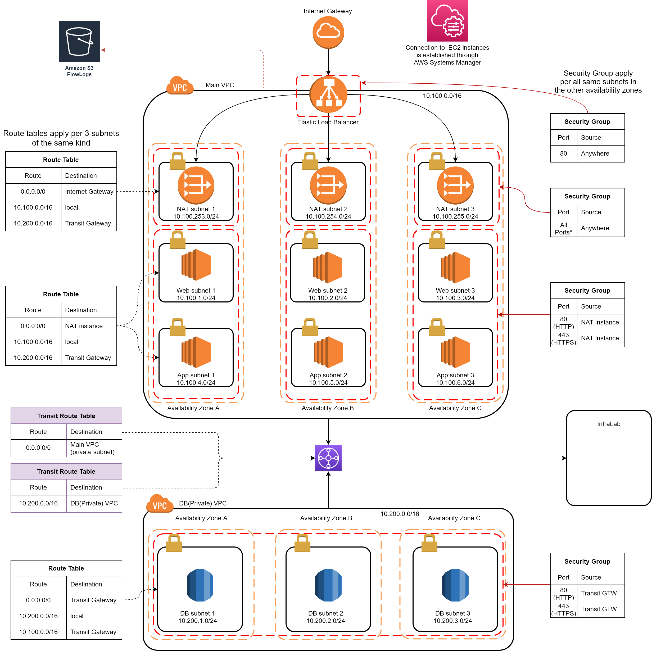
Network diagram No. 2 – “The Real One”

Slide 6
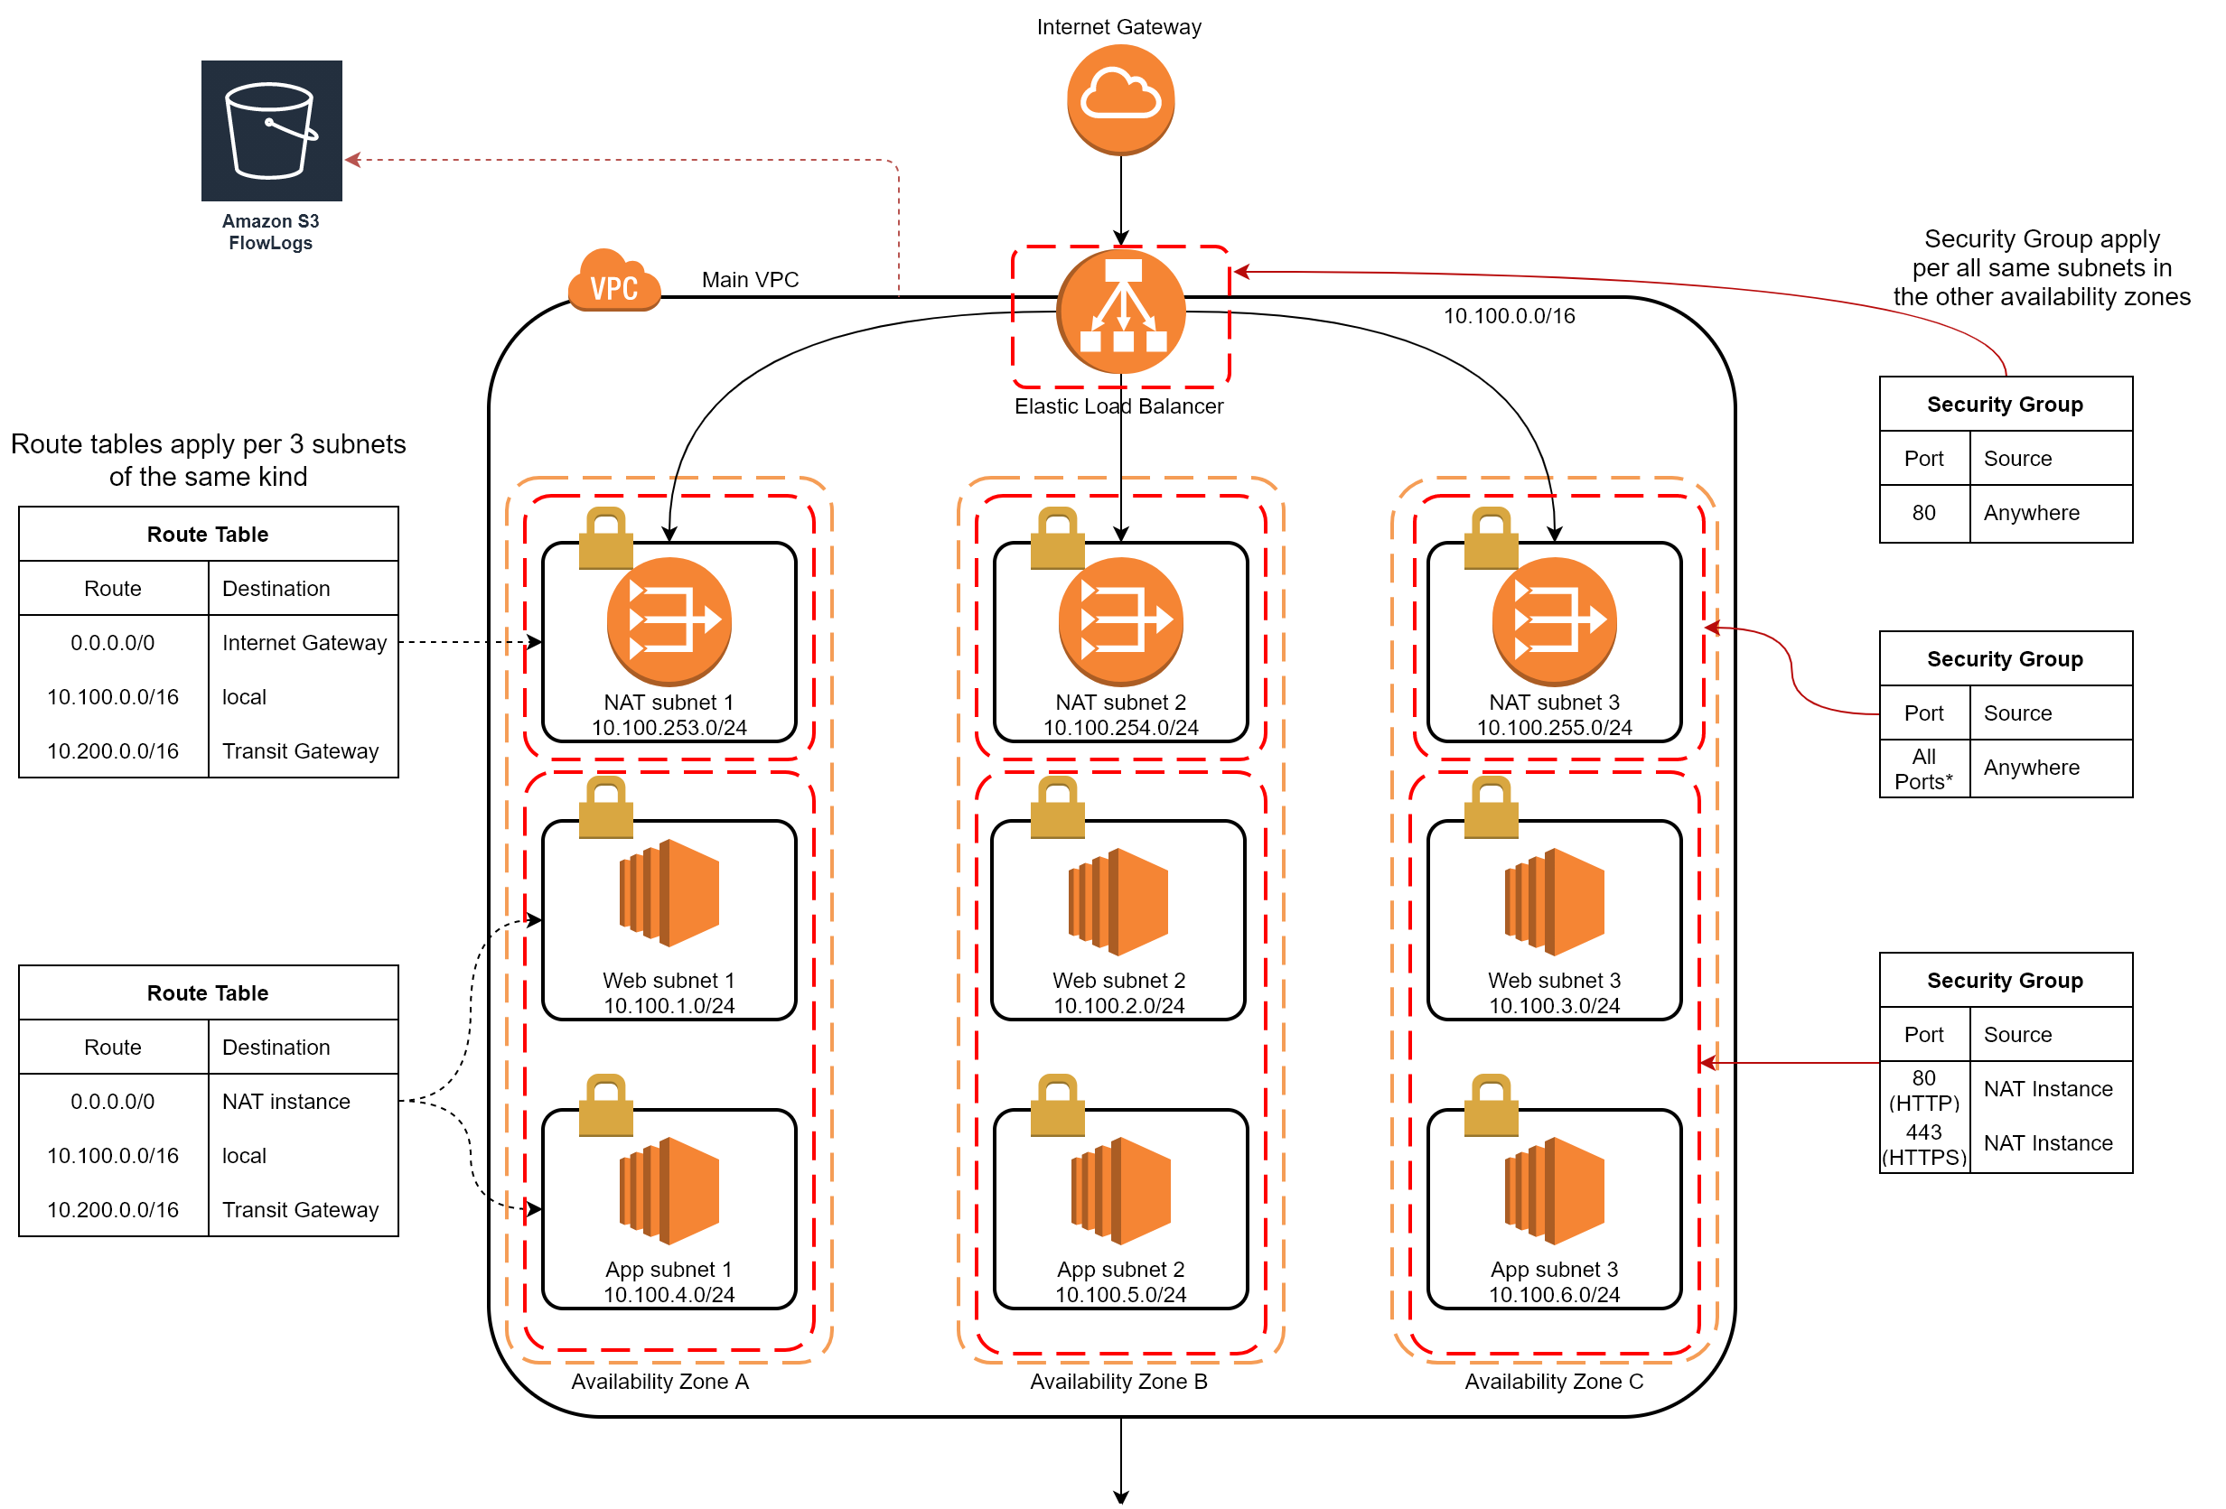

Slide 7
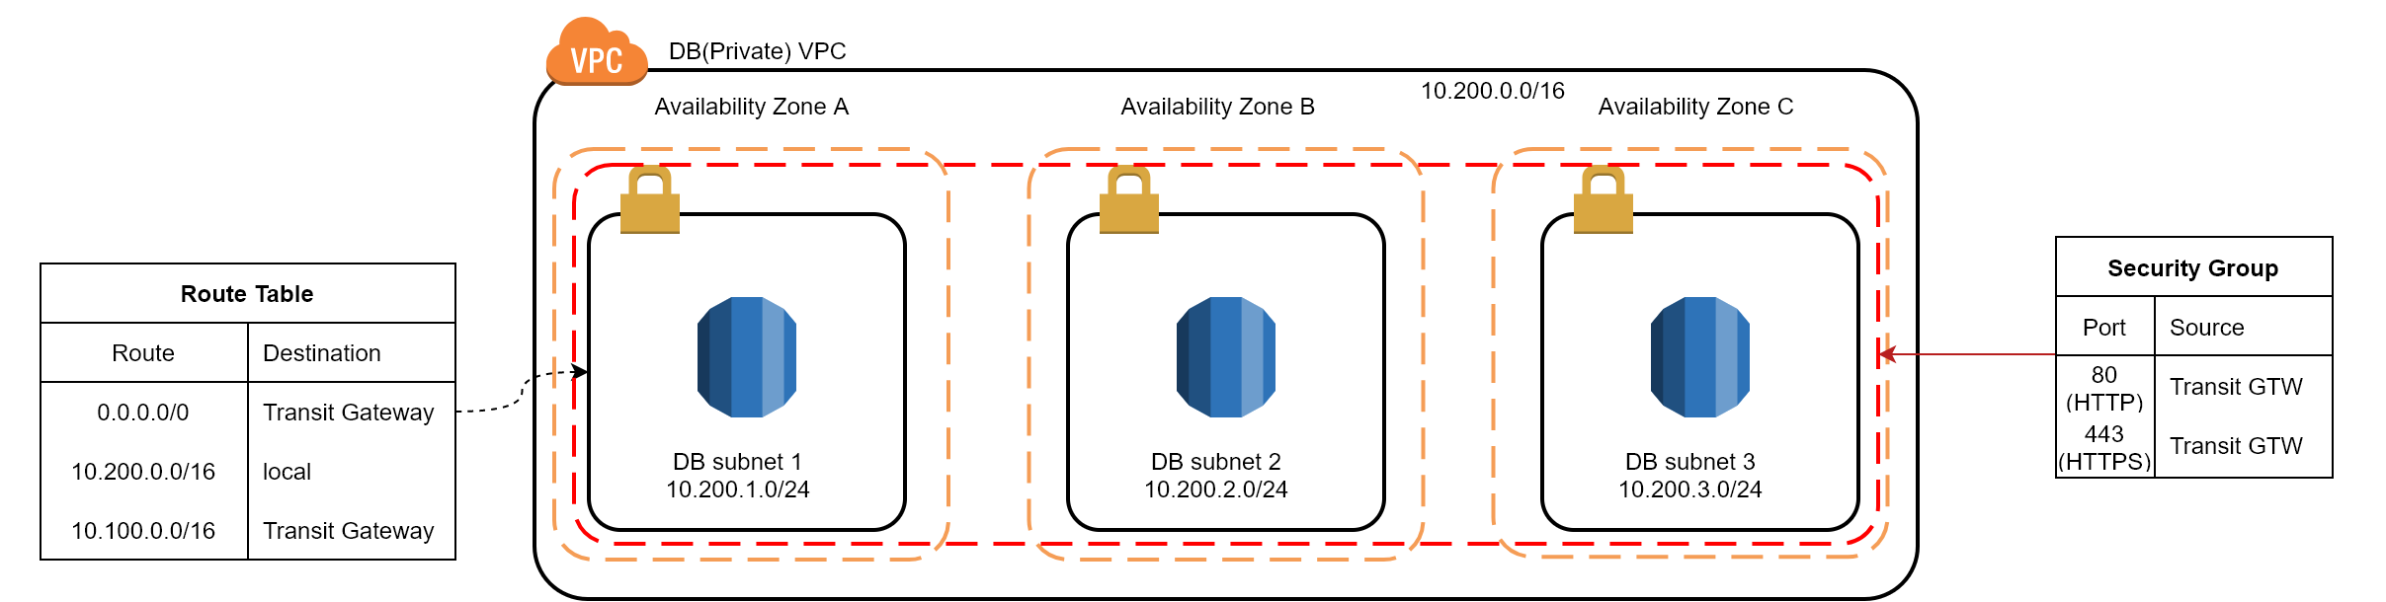

Slide 8
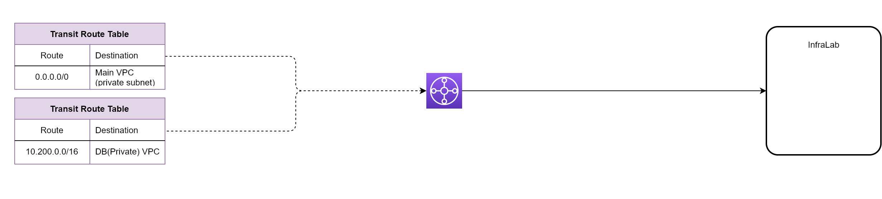

Slide 9

No need for SSH keys!
No need for SSH port to be opened
Is possible to connect from any PC with no need to install any additional software

Slide 10


Automation
Ansible playbooks
SSH key exchange (for avoiding PEM key)
Apache + Flask
Nginx
Terraform (WIP)

Slide 11
Project future vision
Auto Scaling Groups
Monitoring
Terraform
Security Groups
Port Forwarding
Route 53 (DNS)
S3 bucket for hosting media files

Slide 12
Demonstration

Slide 13
Thank you for your attention! ☺

